Slide 1
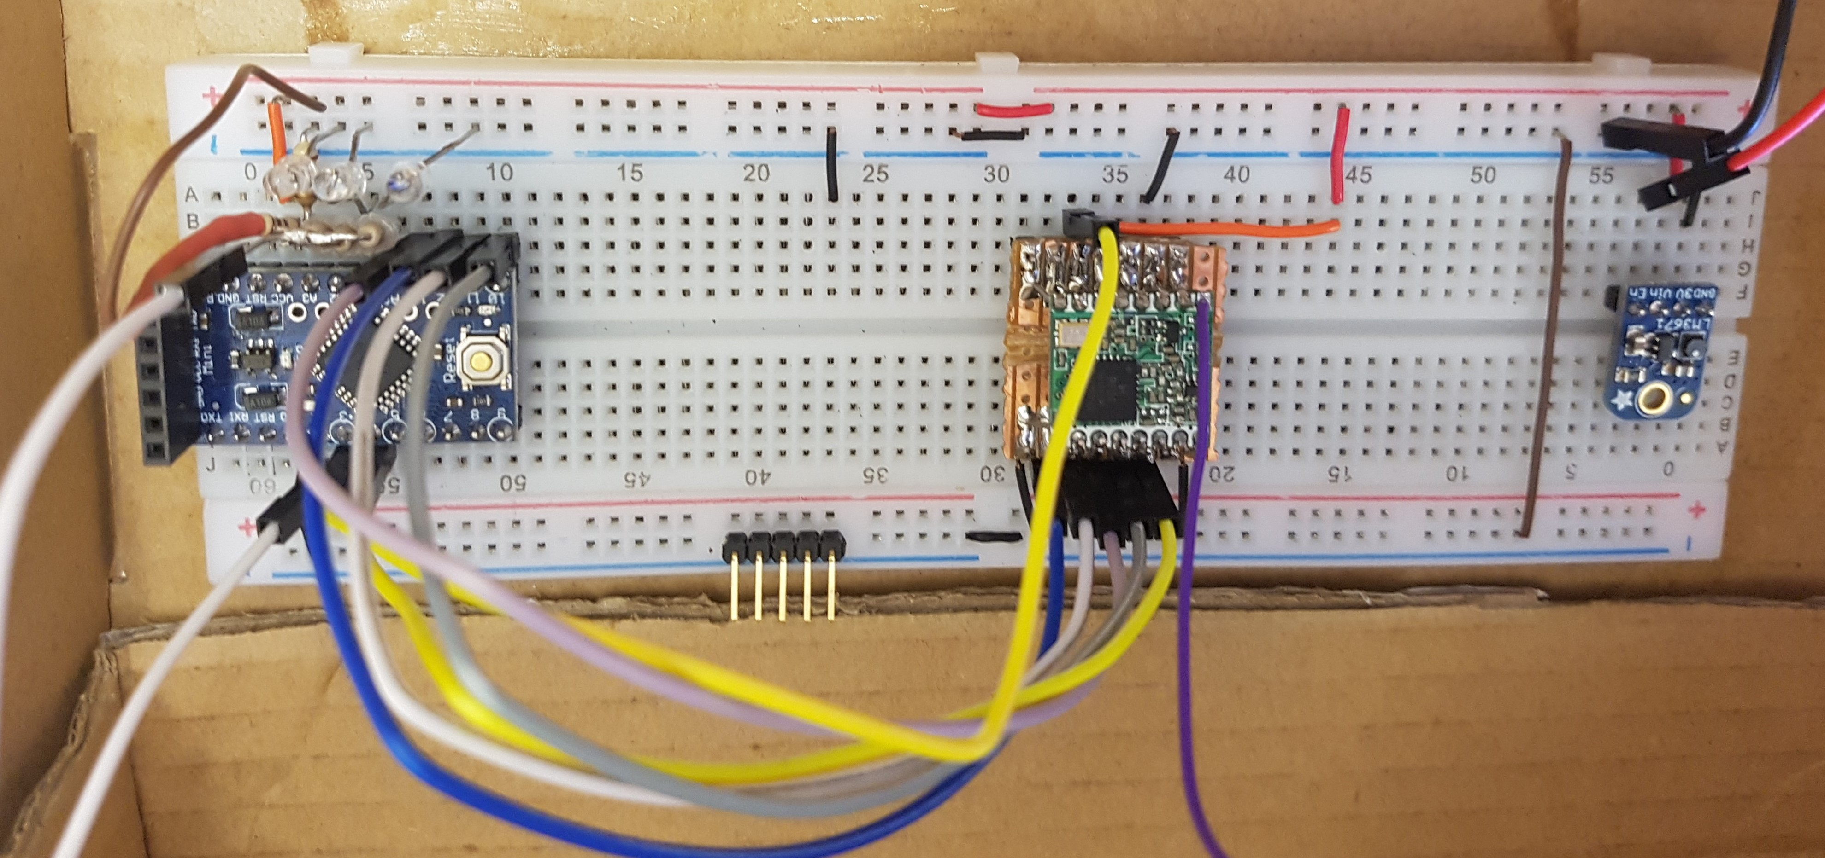
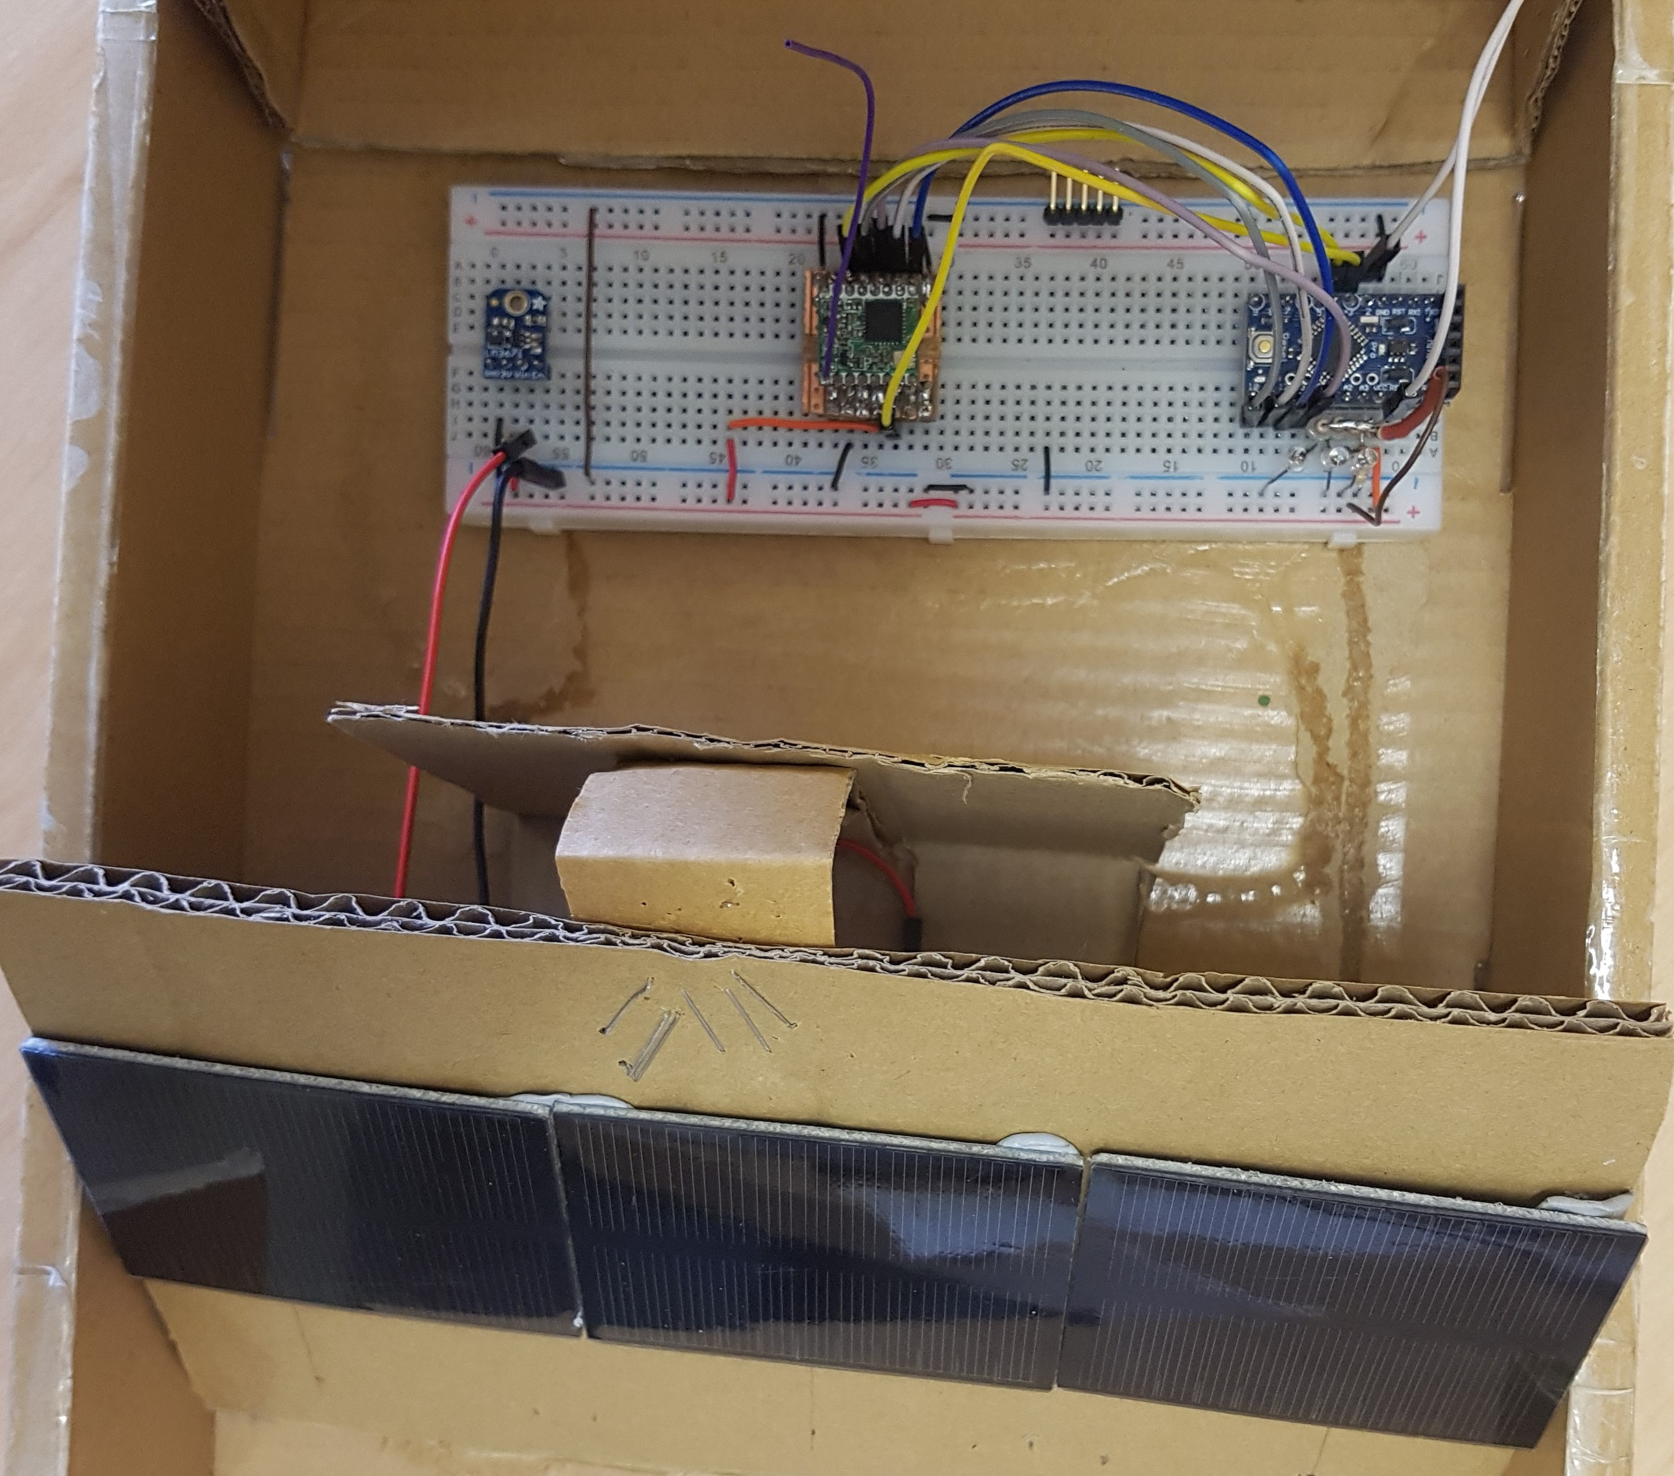
Design of a small satellite UHF Identification and TT&C radio Beacon
PLTOFF Travis McKee
AIM: to provide a design for a self contained UHF radio beacon that provides a satellite identification tag, basic telemetry data and an RF signal that can be tracked by multiple geographically dispersed ground stations. This system will provide an RF signal independent of any failure in a satellite primary system allowing tracking for space monitoring organisations and providing a tool for on-orbit fault finding and rectification to reduce current and future satellite failure rates.
It is estimated that 2000 to 2800 small satellites will be launched into Low Earth Orbit in the next 5 years
322 small satellites were launched in 2018, with nearly 300 released from 12 rideshare launch vehicles
19 of the 64 satellites released from SpaceX Falcon 9 rocket on the 3rd of De, 2018 have not been identified (2 Apr 2019)
Commercial small satellites have a 23% failure rate and Academic institutions suffer a 55% failure rate
Future Work
Develop an efficient power generation, storage and regulation system
Develop a fully integrated PCB design
Completion of all ground tested PCB Prototype
Extension
Develop a full single frequency identification system
Integrate satellite control with in-built cyber security
Intergrade a full receive capability
Full tested system ready for space operations
Design and develop the ground monitoring system
Develop a publicly contributed monitoring concept
A successful bread-board based prototype has been constructed using an Arduino based microprocessor and RFM95 LoRa radio module, powered by 3 silicon based solar panels regulated by a 3.3V Buck converter.

